Slide 1

High school students performance and their future predictions

Slide 2
Why study high school student’s performance?
High school performance of the student reveals many aspects of their future life choices. Studying factors which can affect the student’s performance in high school can provide guidance to the parents and students itself in shaping their future.
Good high school performance can help the student to get into better school with a scholarship, opens the door for better future opportunities, build a better social life by earning respect from teachers and peers. This Study shows how the educational and social experiences affect paths changes of the student's life.

Slide 3
Outline
Data Source
SMART questions
PCA, Lasso, Random forest, Decision tree, Logistic regression
Conclusion
Limitation

Slide 4

Data Source
HSLS (High School Longitudinal Study of 2009)
NCES website & Page navigation:https://nces.ed.gov/surveys/hsls09/
a nationally representative study.
investigates the paths into and out of STEM fields, especially math field.
explores the educational and social experiences that affect paths changes.
surveys of students, their parents, math and science teachers, school administrators, and school counselors.
Total 23503 observations, 60 variables used.

Slide 5
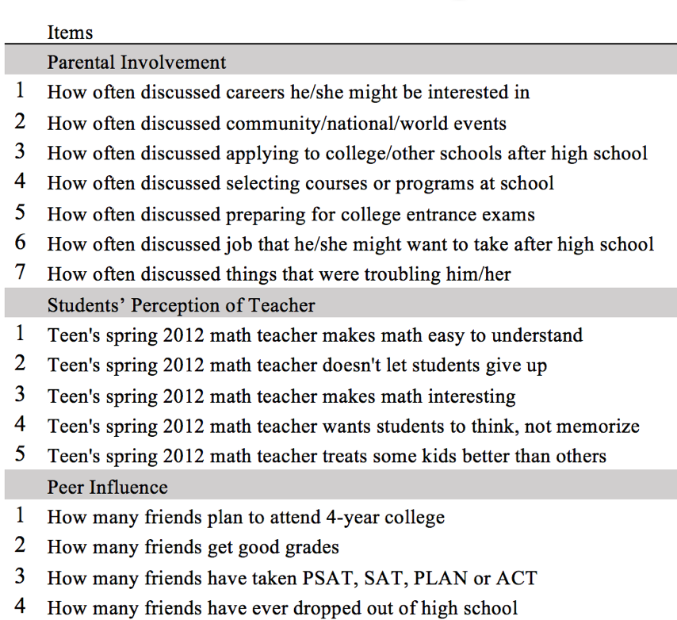
Principal Component Analysis lower dimensional representations of the data

Slide 6
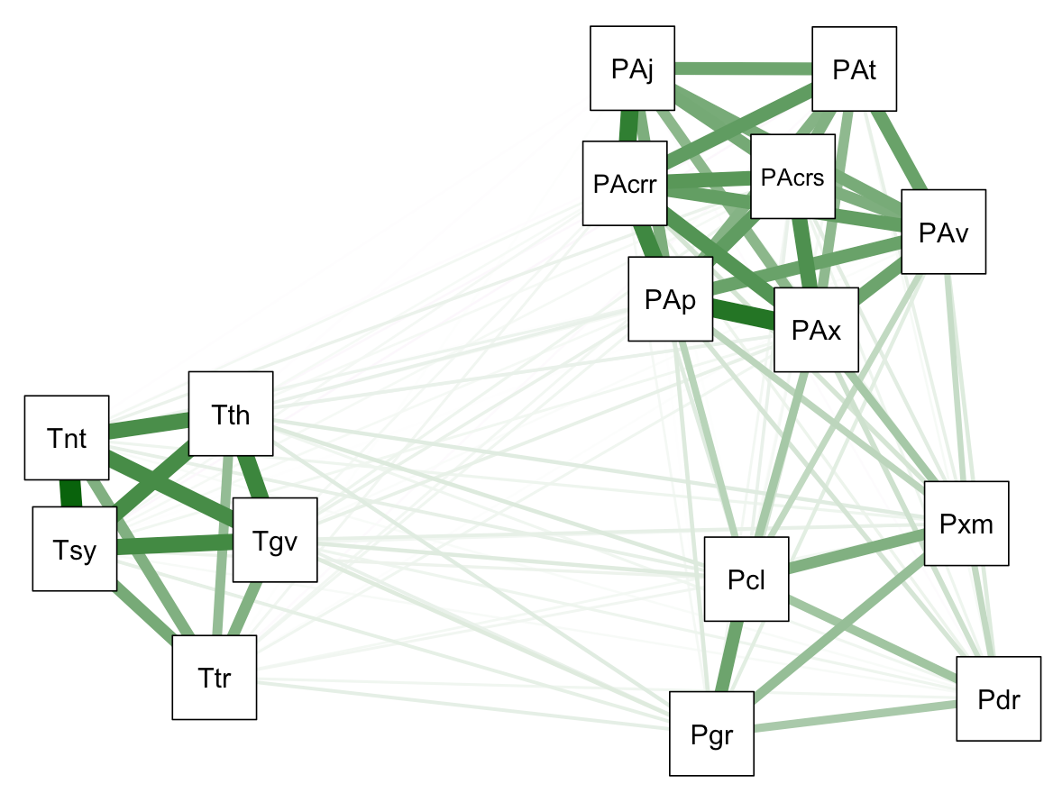
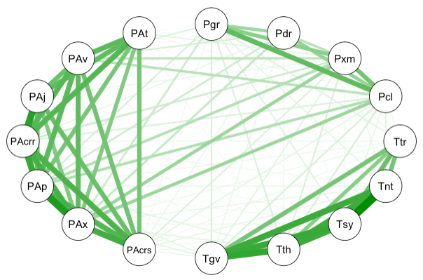
Principal Component Analysis (cont.) Correlation

Slide 7
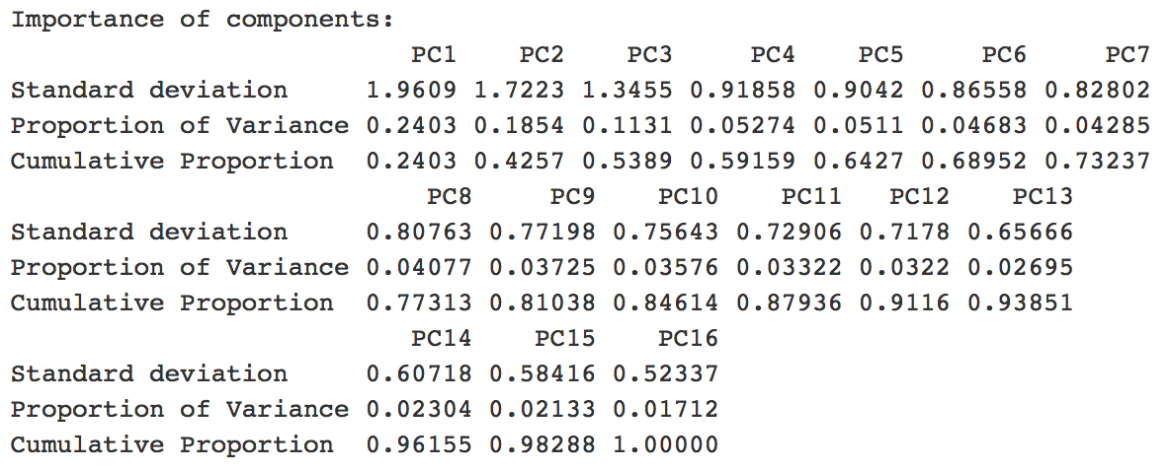
Principal Component Analysis (cont.)

Slide 8
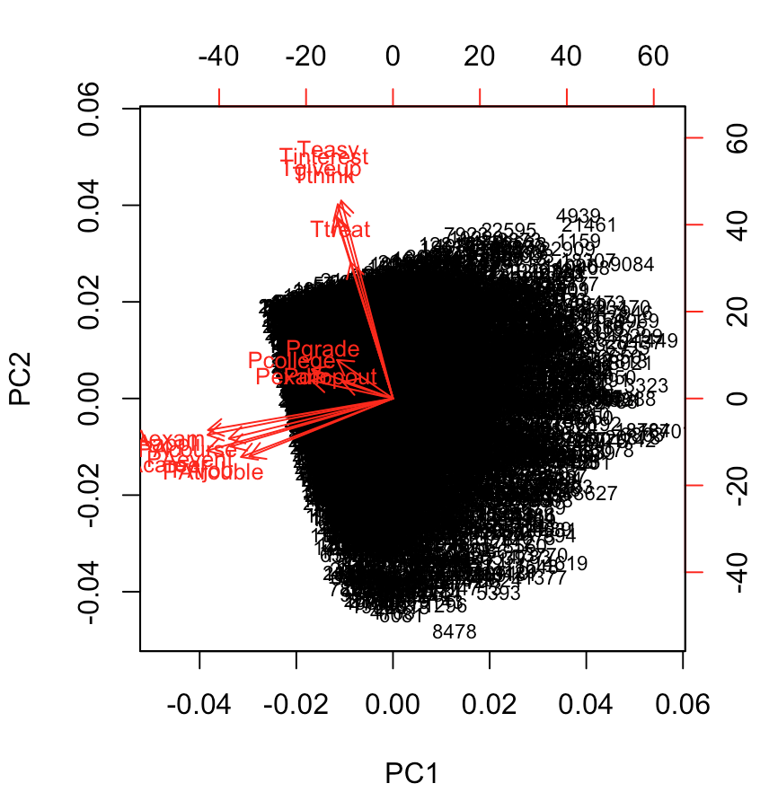
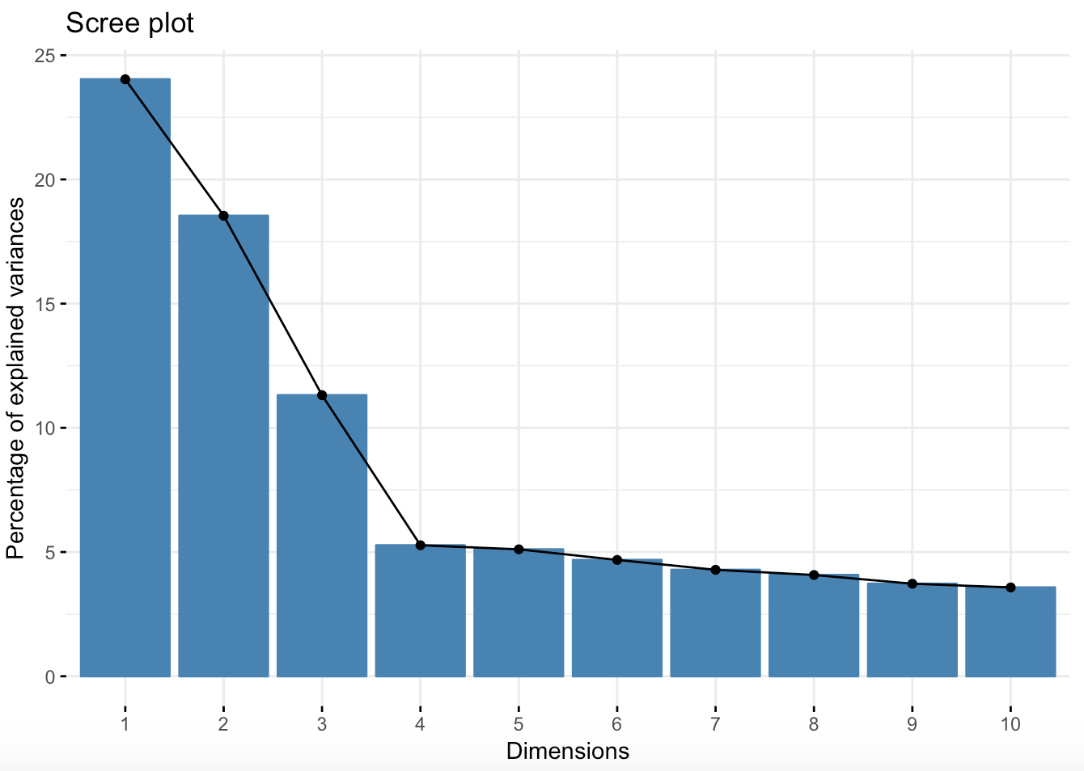
Principal Component Analysis (cont.)

Slide 9
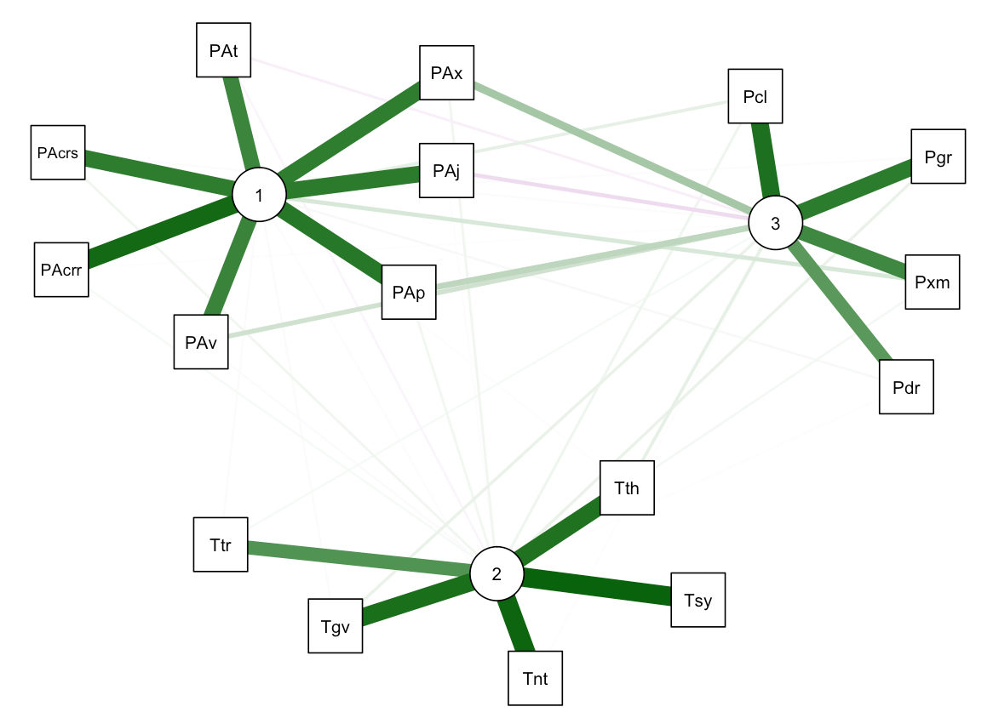
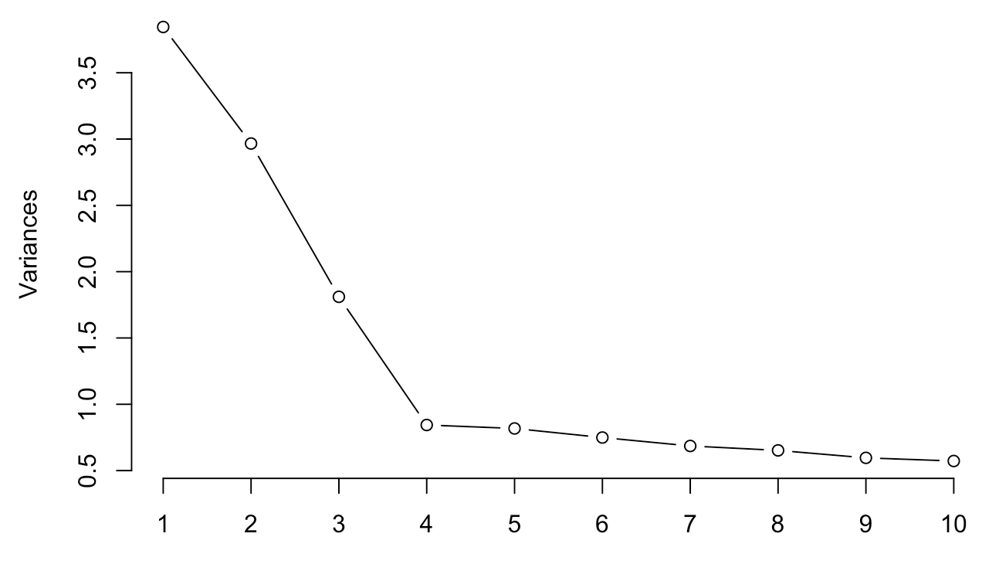
Principal Component Analysis (cont.) Extracting Factors

Slide 10
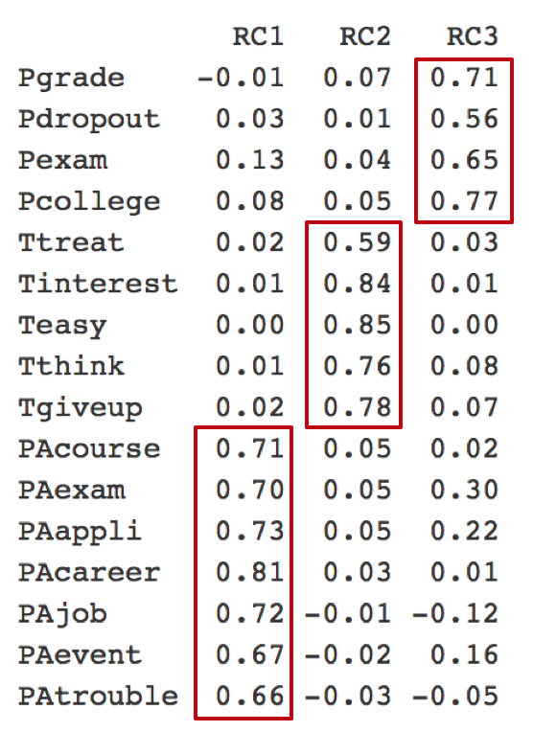
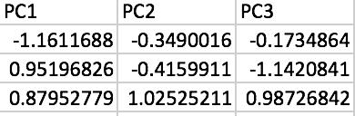
Factor Analysis Generating Factor Scores
e.g.

Slide 11
Smart Questions
What factors determine whether students go to college or not?

Slide 12
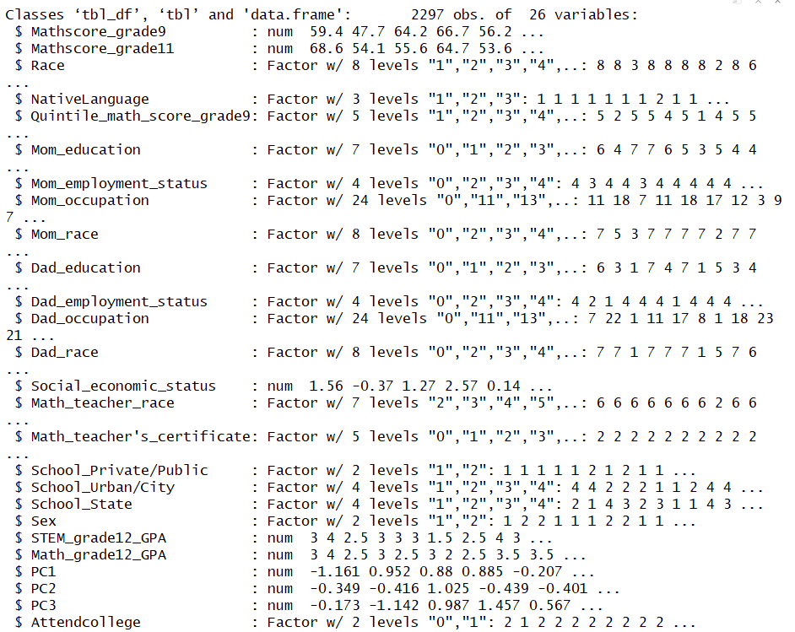
Data structure
25 independent variables, including three PCA result.
Dependent variable: Whether student attend college.

Slide 13
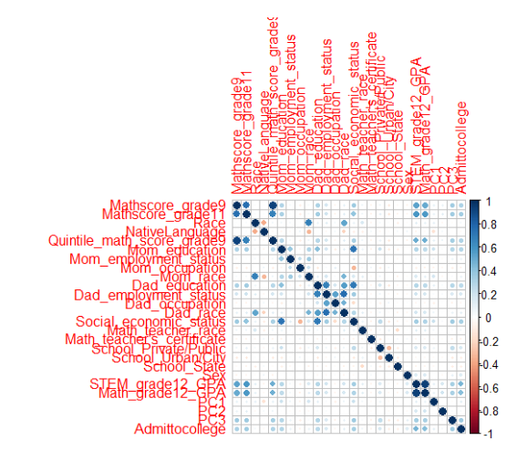
Check Multicollinearity
There are multicollinearity between some variables.
As Lasso can deal with the multicollinearity issue, so we will use Lasso to do the variable selection.

Slide 14
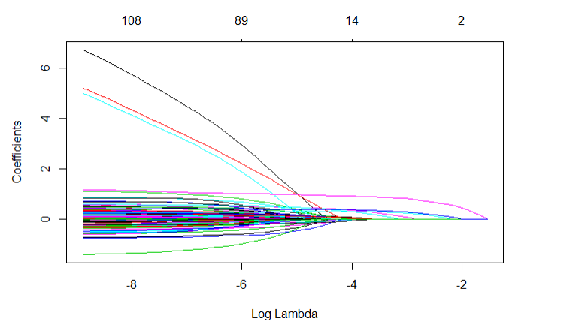
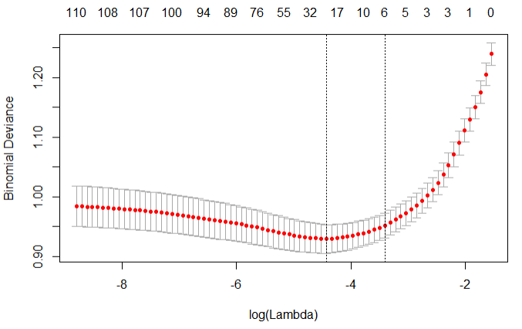
Lasso variable selection
best area
With the increase in Lambda (increase in Log lambda) more and more variables coefficient shrink to 0.
6 variables
lambda = 0.03323185 log.lambda= -3.4

Slide 15
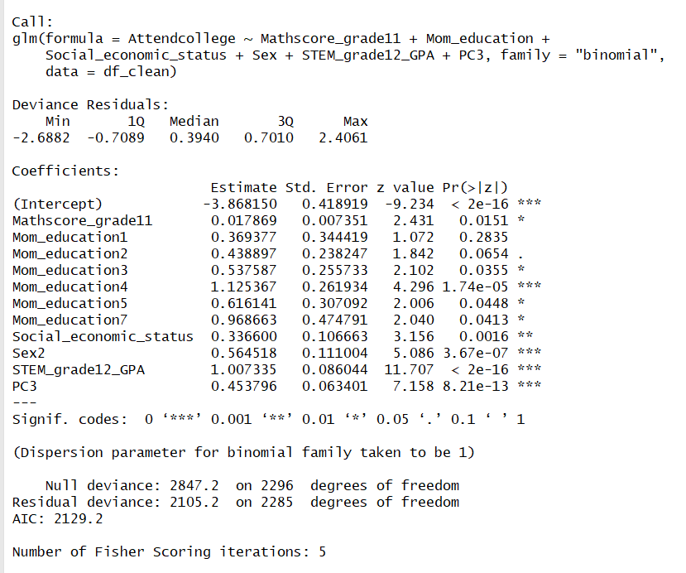
Logistic regression
6 variables selected:
"Mathscore_grade11" "Mom_education" "Social_economic_status"
"Sex" "STEM_grade12_GPA"
"PC3(peer influence)"
Notes:
As coefficient in Lasso shrinked, it is not the origin number, so here we conduct a Logistic regression with the 6 variables to get the correct coefficient.

Slide 16
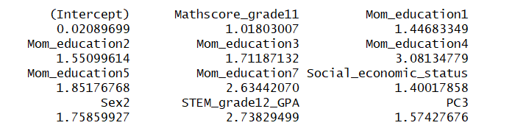
Logistic regression (cont.)
exponential of the coefficient:
Notes:
Is more important in prediction

Slide 17
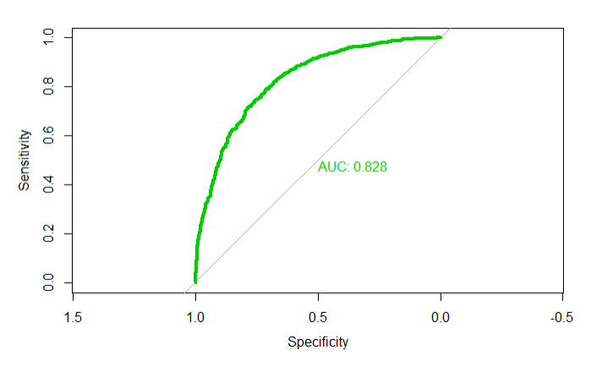
Model evaluation
Notes:
True positive rate False positive Rate

Slide 18
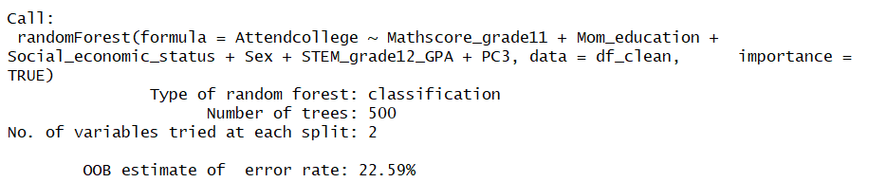
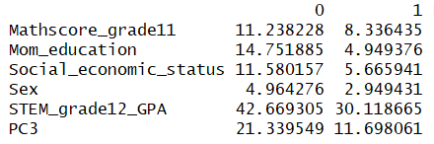
Random Forest
Importance of the variables:
Accuracy: about 77.4%
Notes:
OUT OF BAG ERROR is 22.6. Out-of-bag data is something like test data in Random forest. So We can estimate our accuracy is about 77.4%
The first measure is computed from permuting OOB data: For each tree, the prediction error on the out-of-bag portion of the data is recorded (error rate for classification, MSE for regression). Then the same is done after permuting each predictor variable. The difference between the two are then averaged over all trees, and normalized by the standard deviation of the differences. If the standard deviation of the differences is equal to 0 for a variable, the division is not done (but the average is almost always equal to 0 in that case).
The second measure is the total decrease in node impurities from splitting on the variable, averaged over all trees. For classification, the node impurity is measured by the Gini index. For regression, it is measured by residual sum of squares.

Slide 19
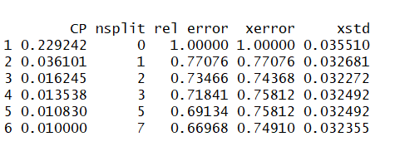
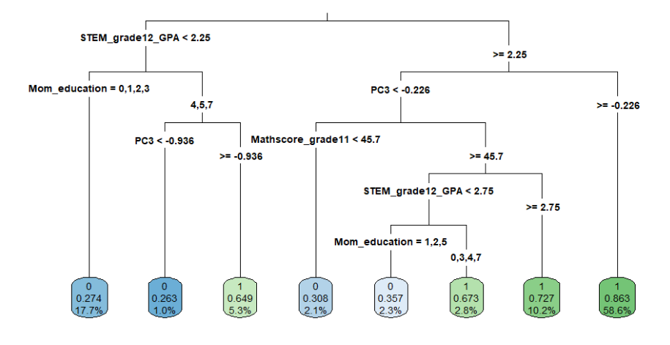
Decision tree
Grow the tree
Set 80% of the data as train data. And 20% as test data.
Choose the lowest xerror, run the pruned tree.
Notes:
Now we will make the decision tree here to make the prediction for our observations from the previous models. Here also we are using the same variables as used in the logistic regression We set 80% of the data as train data and 20% of the data as test data. We use the train data grow a tree first, as shown in the left. AS we can see from the tree Stem grade and Mom educations Level effects the students decision on going to college.
And from the CP table we select the one with the lowest xerror(lowest cross-validation error), which is the third one. And we use this one to make the pruned tree.

Slide 20
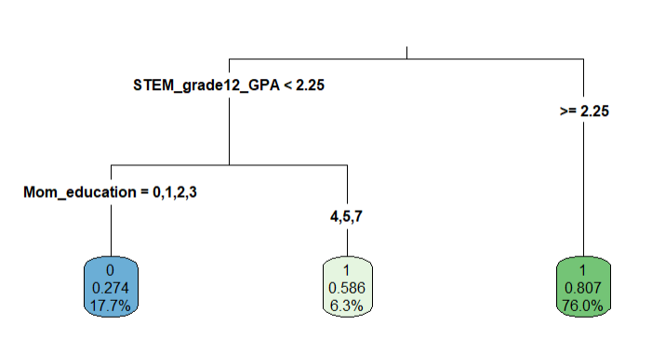
Decision tree
From the Pruned tree we can find the same solution as Logistic regression that STEM GPA and mother education are more important.
STEM GPA higher than 2.25,
Student will go to college.
STEM GPA lower than 2.25, but mother education is higher, student are still going to college.
Pruned Decision tree
Notes:
Now we will create the pruned tree.

Slide 21

Decision tree prediction
Use 20% test data.
Accuracy:77%
Notes:
Contingency Table to predict the accuracy of our model which is 77%. That a good model

Slide 22
Compare these three methods
 | Accuracy | Important Variable
Logistic | 0.83 | STEM GPA | mother education
Random forest | 0.77 | STEM GPA | PC3(peer influence)
Decision tree | 0.77 | STEM GPA | mother education
Notes:
We will compare these three models as we have used the same 6 variables . Accuracy Rate here is higher for Logistic Regression. but they all have same variable Mother Education Level, then the Stem GPA is also a important factor, Peer Influence also one of the factors.

Slide 23
Smart Question
What are the responsible factors for income, when students start working?

Slide 24
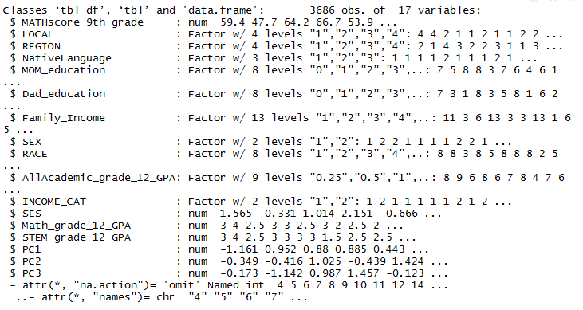

Subset Selection and Logistic Regression
GLM with 16 independent variables (mixed)

Slide 25
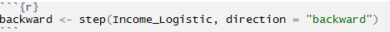
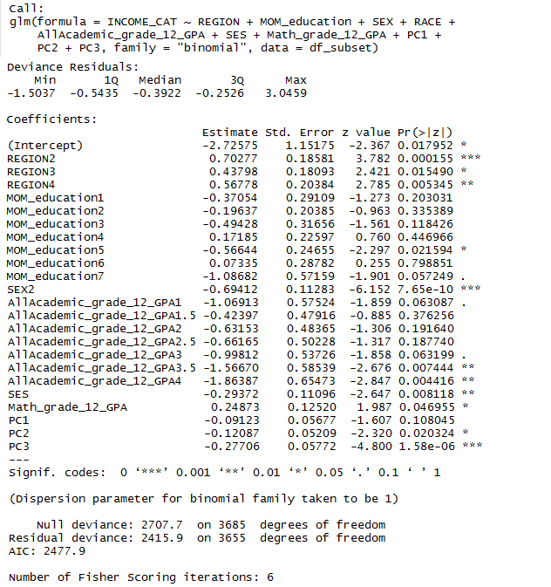
Model selection
Reduced model variable to 9: Region, Mom edu, gender, 12th grade academic GPA, SES, 12th grade Math GPA, Peer support, teacher support, parents support.
Select model with lower AIC in comparison
McFadden value of 10% - Not Bad for social science data

Slide 26
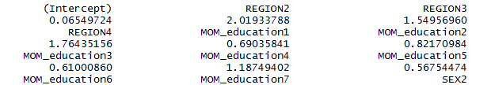
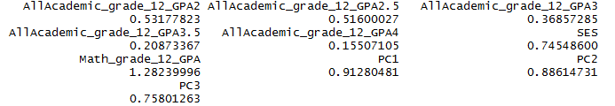
Exponentials of Coefficients

Slide 27
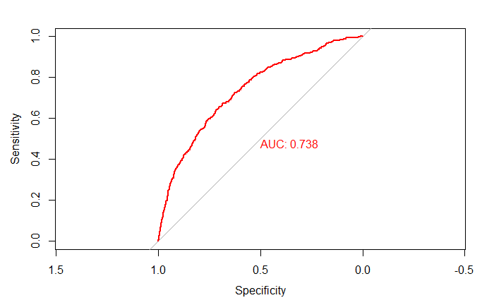
Model evaluation

Slide 28
Conclusion
Three underlying structures from PCA: parents involvement, students perception of teacher support, and peer influence.
Essential factors that influence student whether attend college are: Students Math score, mother education, family’s socioeconomic status, gender, STEM GPA , and peer’s performance.
Essential factors that influence student income when they start working are: Region, mother’s education, gender, socioeconomic status, final academic GPA of high school, teacher and peer’s performance.
From the analysis, we can say that family socioeconomic status, mothers education level, and peer’s performance are really important in a student’s life.

Slide 29
Limitation
Cross-sectional design: no causal assumptions
Self-report data:may contain social desirability bias
Some data is not accessible for public
Notes:
Our data is cross-sectional ,it's hard to find causal assumption. it is hard to determine the direction of influence using cross-sectional data.
If we can request such kind of data from the organization, our analysis may improved.

Slide 30
Questions?

